Slide 1
Application Layer Protocols

Slide 2
Application Layer Protocols
Application Layer Protocols The various protocols in application layer are :
FTP
Telnet
SMTP
HTTP
DNS
POP.

Slide 3
FTP
The File Transfer Protocol (FTP) is a standard network protocol used to transfer computer files between a client and server on a computer network.
FTP is built on a client-server model architecture and uses separate control and data connections between the client and the server.

Slide 4
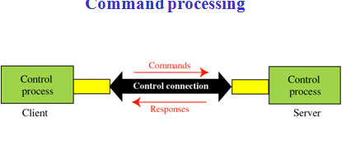
It is a standard mechanism provided by TCP/IP for copying file from one host to another. FTP uses the services of TCP. It needs two TCP connections. The well-known port 21 is used for the control connection and the well-known port 20 for the data connection.

Slide 5
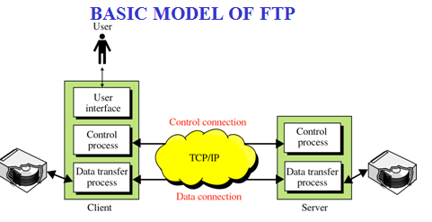
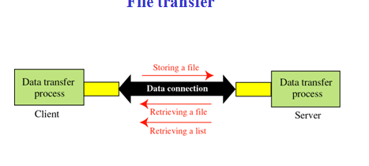
FTP contacts the remote computer using the TCP/IP software.
Once the connection is established, the user can choose to download a file from the computer or the user can send a file from his computer to be stored on the remote computer.

Slide 6
FTP presents the user with a prompt and allows entering various commands for accessing and downloading files that physically exist on a remote computer. After invoking an FTP application, The user identifies a remote computer and instructs FTP to establish a connection with it. FTP contacts the remote computer using the TCP/IP software. Once the connection is established, the user can choose to download a file from the computer or the user can send a file from his computer to be stored on the remote computer.

Slide 7
TELNET
TELNET is a general-purpose client-server application program.
TELNET enables the establishment of a connection to a remote system in such a way that the local terminal appears to be a terminal at the remote system. TELNET has two parts, the client and server.
The client portion of TELNET software resides on an end user’s machine, and the server portion resides on a remote server machine.
This server is the TELNET server, which provides an interactive terminal session to execute commands on the remote host.
In timesharing systems, all users log into the centralized server and uses its resources. This is called local login.

Slide 8
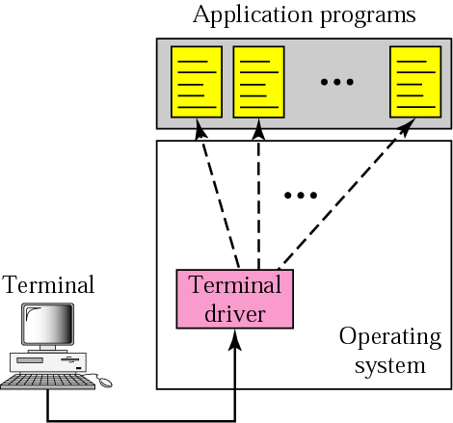

Slide 9
A user’s terminal sends the commands entered by the user from the terminal is carried to the terminal driver which is running on the server and it is the part of the server machine operating system.
The terminal driver then sends the requests to the appropriate module of the server operating system.
The operating system then processes this commands and invokes the appropriate application program, which executes on the server machine and the result is send back to the terminal.

Slide 10
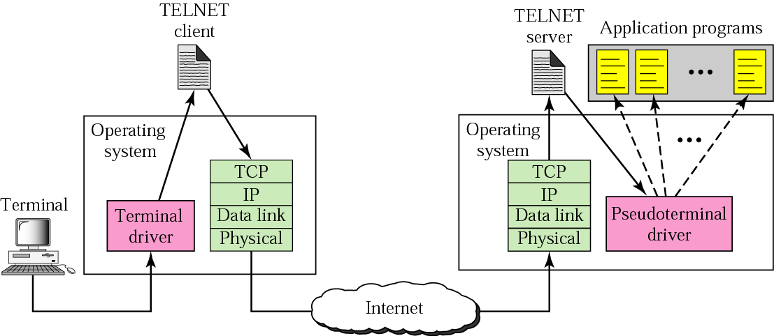
The commands from the terminal is sent to the operating system of common server computer as that in local login the commands are not interpreted but sent to the TELNET client translates characters (data or commands) that come from the local terminal into NVT form and delivers them to the network.
The TELNET server translates data and commands from NVT form into the form acceptable by the remote computer. The pseudo-terminal driver is a software program which handles the commands from the terminal via TELNET Server which invokes the appropriate application on the remote server.

Slide 11
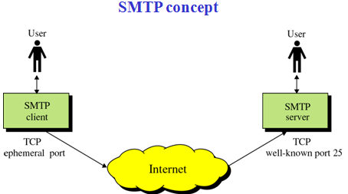
SMTP
Simple Mail Transfer Protocol (SMTP) is used to send mail across the internet.

Slide 12
The TCP/IP protocol that supports electronic mail on the internet is called SMTP. It is the system for sending messages to other computer users based on e-mail addresses. SMTP provides for mail exchange between users on the same or different computers and supports:
1. sending single message to one or more recipients.
2. sending messages that include text,voice,video or graphics.
3. sending messages to users on networks outside the internet.

Slide 13
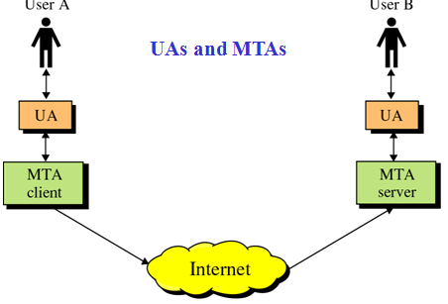
UA - users agent.
This is the program a user will use to type e-mail. It usually incorporates an editor for support. The user types the mail and it is passed to the sending MTA.
MTA
Message transfer agent is used to pass mail from the sending machine to the receiving machine. There is a MTA program running on both the sending and receiving machine

Slide 14
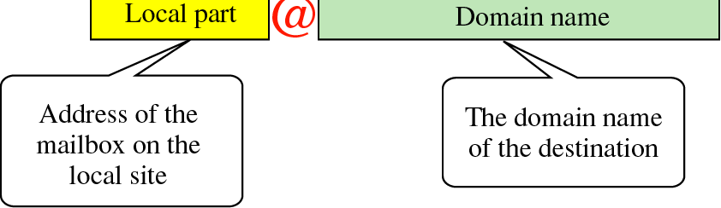
The address format used for sending mail in general which is called email id to communicate.

Slide 15
HTTP
One of the application layer protocol is HTTP. Hyper Text Transfer Protocol.
HTTP is the underlying protocol used by the World Wide Web and this protocol defines how messages are formatted and transmitted, and what actions Web servers and browsers should take in response to various commands.
For example, when a URL is entered from a client browser, this actually sends an HTTP command to the Web server directing it to fetch and transmit the requested Web page.
Some of the HTTP commands are: GET,HEAD,PUT,POST,DELETE,LINK

Slide 16
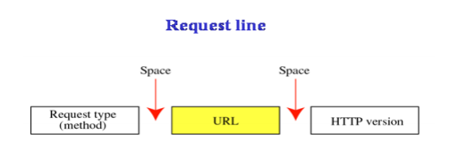
The client submits an HTTP request message to the server.
The server, which provides resources such as HTML files (web pages) and other content, or performs other functions on behalf of the client, returns a response message to the client. The response contains completion status information about the request and may also contain requested content in its message body.

Slide 17
POP3
The Post Office Protocol (POP3) is an Internet standard protocol used by local email software clients to retrieve emails from a remote mail server over a TCP/IP connection.
Email servers hosted by Internet service providers also use POP3 to receive and hold emails intended for their subscribers.
Periodically, these subscribers will use email client software to check their mailbox on the remote server and download any emails addressed to them.
Once the email client has downloaded the emails, they are usually deleted from the server, although some email clients allow users to specify that mails be copied or saved on the server for a period of time.
Email clients generally use the well-known TCP port 110 to connect to a POP3 server.

Slide 18
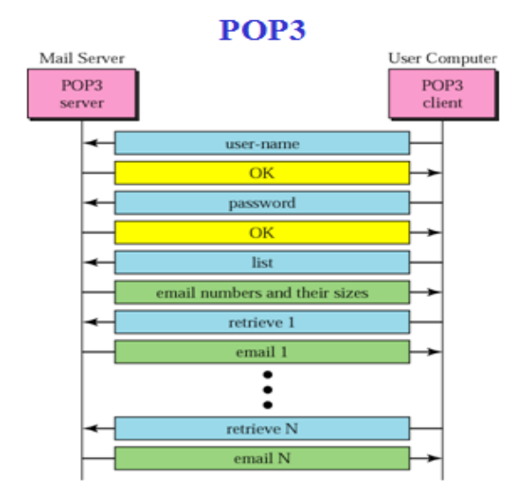

Slide 19
DNS
DNS - Domain Name System A simple idea in identifying computer networks and computers on those networks by some name is the basis for domain names.
Domain name is a name given to a group of computers that are called by single name is called Domain.
These Domain names are to be translated to its respective IP addresses because this IP address is handled by the TCP/IP or the internet understands while sending and receiving any messages.
This translation is handled by DNS. The Domain Name System (DNS) is basically a large database which resides on various computers and it contains the names and IP addresses of various hosts on the internet and various domains.
The Domain Name System is used to provide information to the Domain Name Service to use when queries are made.
The service is the act of querying the database, and the system is the data structure and data itself.
The humans use domain names when referring to computers in network whereas computers use IP addresses.

Slide 20
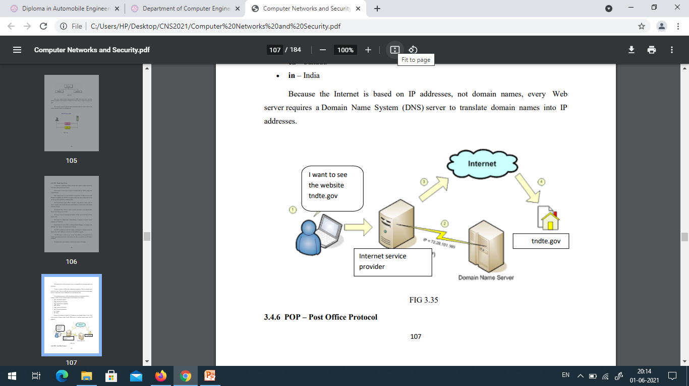

Slide 21
Domain names are used in URLs to identify particular Webpages.
For example, in the URL http://www.tndte.gov the domain name is tndte.gov.
The DNS is distributed, means the database containing the mapping between the domain names and IP addresses is scattered across the different computers.
The DNS system is, in fact, its own network.
If one DNS server doesn't know how to translate a particular domain name, it asks another one, and so on, until the correct IP address is returned. The domain name system database is divided into sections called zones.

